Slide 1
Speaker Notes
This deck is part of “App Camp in a Box”, a set of material to accompany the App Camp labs in an in-person workshop.
Instructors are strongly encouraged to watch the App Camp videos and complete the labs before delivering or proctoring App Camp! https://aka.ms/app-camp
Instruct your students to do the labs at that same location – https://aka.ms/app-camp
⬇️ Don’t forget to check the speaker notes! ⬇️

Slide 2
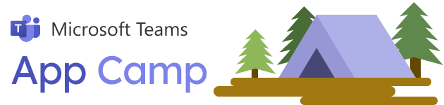

Understanding Azure Active Directory
Notes:
Welcome the students to Microsoft Teams App Camp! Students will learn how to extend a web application to be a full-featured Microsoft Teams app, and how to sell it in the Microsoft Teams app store.

Slide 3
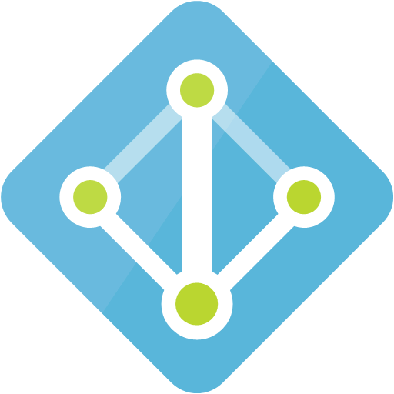
Microsoft Azure Active Directory ”Single Sign-On in the cloud”
On-premises AD federation
Multi-factor authentication
B2B federation
Azure subscriptions
Web browsers
Azure AD
Native applications
AuthN AuthZ
Microsoft 365
Daemon applications
Synchronise users from Active Directory on-premises
Azure Active Directory
Your apps
Tenant
Multi-tenant partner apps
Application gallery
Consent model
Conditional access
Self-service password, group management
Notes:
Azure Active Directory is the identity service used by Microsoft 365 as most of Microsoft Azure. Azure AD provides single sign-on across both first-party and third-party products. These products may be browser based, native apps that run on a computer or mobile device, and background (daemon) applications.
Azure AD is often used in enterprises for employee access. It’s possible to synchronize Azure AD with the on-premises Active Directory; this allows companies to operate hybrid environments that span both the cloud and on-premises data centers.
In addition to a consent model, which we’ll explain shortly, Azure AD provides multi-factor authentication, self-service password and group management, and conditional access. Conditional access allows administrators to limit users to certain hours or locations when accessing applications.

Slide 4
Why should Teams apps support Azure AD?
Works across all the devices where a user runs Teams – no extra login prompts!
Includes key security features like multi-factor auth and conditional access
Easier for users: no extra usernames or passwords to remember
Easier for team owners: no need to match M365 logins to app logins when assigning permissions
Easier for M365 admins: one place to disable access for departing team members
Required for monetization in the Teams store
Required for the Microsoft 365 App Compliance program
Notes:
Azure AD is not required of Teams apps, but apps that don’t support it will end up with extra login prompts and other hassles.

Slide 5

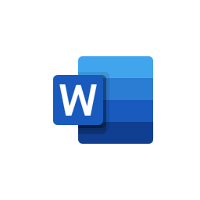
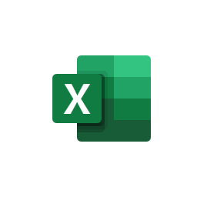

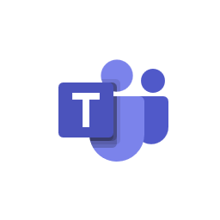

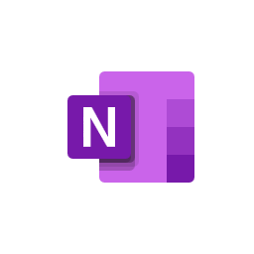
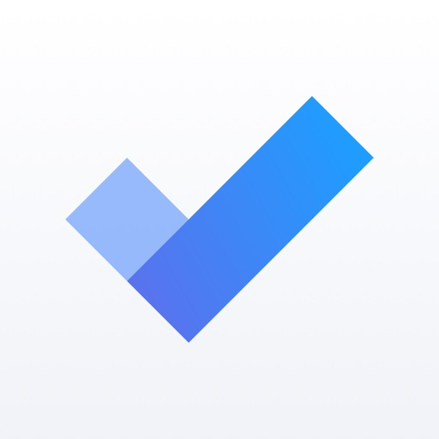
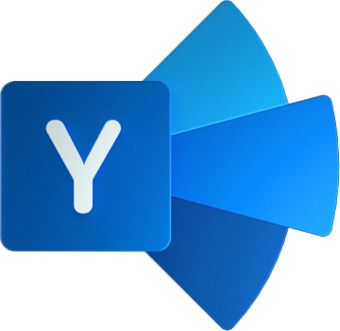
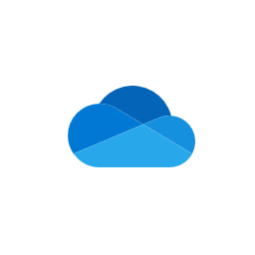
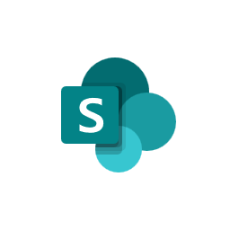
Microsoft 365
Word
Excel
PowerPoint
Teams
Outlook
OneNote
ToDo
Yammer
OneDrive
SharePoint
Notes:
As you know, Microsoft 365 provides a collection of popular Microsoft applications in a single package.

Slide 6
Microsoft 365
Word
SharePoint
Excel
OneDrive
PowerPoint
Azure Active Directory
ToDo
Teams
Yammer
Outlook
OneNote
Notes:
What all these apps have in common is Azure Active Directory, which is the identity system used throughout Microsoft 365.

Slide 7










Microsoft 365
Subscription
Word
SharePoint
OneDrive
Users
Excel
Users
Azure Active Directory
ToDo
PowerPoint
YOUR APP
Guest users
Yammer
Teams
OneNote
Outlook
Tenant
Notes:
When someone purchases Microsoft 365 they get a “tenant”.
A tenant is both a storage container and an administrative container for any kind of organization that purchases a subscription.
Each tenant has exactly one Azure AD directory instance.
The tenant’s users are stored in this directory. The M365 applications store user files and other data by tenant and grant permissions based on these users and groups of users.
Guest users are also stored in the directory instance, but they authenticate in their home system (this is a form of directory federation called Azure AD B2B).

Slide 8
Azure AD Concepts
App Registration
Application ID – uniquely identifies an app
App Secret – effectively the password for app “service account”; not used w/implicit flow
Redirect URI – used to direct responses back to your app
More depending on the flow you plan to use
Resources – e.g. https://graph.windows.net or your app’s GUID These are apps secured with Azure AD - not to be confused with ARM resources
Scopes – e.g. Directory.Read These are permissions that are specific to each resource
Azure Active Directory
Notes:
Here are the big concepts to understand about Azure AD – or any OAuth 2.0 based identity provider.
Apps must be registered in order to authenticate users or to gain access to other Azure AD applications
Applications have resources, which are items that can have permission set on them. For example, an app may control access to particular files, messages, events, etc. based on these permissions. Some apps just have a single resource such as “access_as_user”.
Scopes are the permissions that apply to resources. For example, a user may have Read or ReadWrite access to a file resource.

Slide 9

A better permission model
Old School OS
Modern OS
Applications are just files in the filesystem; users can run any application they want
Applications have 100% of permission of the user who runs it
Issue: users have no way to know 100% what the application is doing
Applications must be registered
Applications need permission to access resources
Users and/or admins must consent to these permissions
Nice game!
Notes:
Why go to all this trouble?
Most of us have used a computer where applications run with the same permission as the user who runs them. This is still prevalent in computers that run Windows, MacOS, and Linux, though Windows and MacOS have app stores that allow more advanced application permissions.
Most users will be familiar with app permissions from their mobile phones, which sometimes ask if it’s OK to permit an application to access the camera, calendar, etc.
This user is playing a game, but in the background the game is reading her contacts list and sending them all unsolicited email!
This is why we need app permissions.
With a modern OS, the application would have to ask for permission to read her contacts; either a user or administrator needs to consent, or the application can’t access them.
Azure AD is such a modern system, and it uses a similar scheme for both local apps and online services.

Slide 10

Four confusions of Azure AD
Product naming confusion
Tenants and Subscriptions
Terminology confusion
Permission confusion
Notes:
Azure AD can be pretty confusing!
Let’s look at the top 4 areas where people get confused.

Slide 11
1. Azure AD Versions and Variations
 | Azure AD
Azure ACS | v1 Endpoint | v2 Endpoint | Azure AD B2C
Federation with “social” accounts (Google, Facebook, Microsoft, etc) | Azure AD only | “Unified” Azure AD + Microsoft accounts | Federation with “social” accounts (Google, Facebook, Microsoft, etc)
Static consent model | Static consent model | Dynamic consent model | Static consent, admins only
 | Program with ADAL | Program with MSAL | Program with MSAL
Only remaining use is SharePoint and Office Add-ins | Easy to write your own services | Easy to write your own services | Highly scalable Highly customizable No “on behalf of” flow
Register in Azure Service Bus (or in SharePoint for add-ins and S2S) | Unified Registration Portal | Register in Azure Portal (new UI) | Azure Portal B2C
Deprecated
Notes:
“There is nothing permanent except change” – Heraclitus
There are really 4 different services that are similar and easy to confuse.
Azure Access Control Services is a now-deprecated technology for federating with consumer accounts as well as Azure AD directories. Azure AD ACS is still used in some SharePoint and Office add-ins, but it’s been deprecated and is being phased out. If you see some documentation or a sample referring to this technology, it’s not for building Teams apps.
Azure AD B2C is a new service that allows federation with social media accounts and Microsoft consumer accounts. Despite the branding, is not compatible with Azure AD and cannot be used to build Teams apps.
That leaves Azure AD itself, which _is_ used to build Teams apps. This is where your app will be registered and user accounts are stored. The v1 endpoint still works but is being phased out. The SDK for the v1 endpoint is called ADAL (AD Authentication Library) The v2 endpoint has some improved features such as a dynamic consent model, so apps can request more permissions when they need them instead of requiring all the consents up front. The v2 endpoint can also be used to authenticate Microsoft consumer accounts. The SDK for the v2 endpoint is called MSAL (Microsoft Authentication Library)
If you’re writing a Teams app you want the v2 endpoint of Azure AD.

Slide 12
2. Tenants and Subscriptions
An M365 tenant is an Azure AD domain
An M365 subscription is used to charge for M365 services An Azure subscription is used to charge for Azure services
Your app can be single-tenant or multi-tenant
Notes:
SUBSCRIPTION CONFUSION
If your application is registered as single-tenant, it will only be usable within that tenant

Slide 13



2. Tenants and Subscriptions
1
1
1
n
M365 subscriptions have a 1:1 relationship with Azure AD domains
An Azure subscription can trust only one Azure AD domain
Many Azure subscriptions can trust an Azure AD domain
Notes:
SUBSCRIPTION CONFUSION
Many Azure subscriptions can be tied to a single Azure AD instance, but it’s always a 1-to-1 relationship between Microsoft 365 subscriptions and directories.
If someone gives you an Azure subscription, pay attention to what Azure AD instance it trusts. Some Azure features will assume your app is registered in this domain this is a common source of confusion. Also, additional steps are required if you want to run a multi-tenant app from another tenant. When you’re getting started, you’ll find it easier if both Azure and Microsoft 365 are associated with the same Azure AD instance.

Slide 14

3. A rose by any other name is … confusing!
Tenant ID, Directory ID
App ID, Application ID, Client ID
App Secret, App Key, Client Secret
Enterprise Application, Service Principal
Unique identifier for an instance of Azure AD
Unique identifier for an application
Password used to authenticate the application
App registration applied to a service, possibly in another tenant
Notes:
TERMINOLOGY CONFUSION
“The beginning of wisdom is the definition of terms” – Plato
“A rose by any other name would smell as sweet” – Shakespeare
These terms are used interchangeably in Microsoft documentation and in the Azure portal. Don’t be confused if one document refers to a Client ID and a sample uses the Application ID. They are the same globally unique ID (GUID).

Slide 15
4. App types and permission types
User Delegated Permissions (Get access on behalf of users)
App Permissions (Get access as a service)
App type
Who can consent
Effective Permissions
Mobile, Web and Single page app
Service and Daemon Elevate permissions
Delegated permission (user permission)
Application permission
Users can consent
for their data
Admin can consent
for them or for all users
Only admin can consent*
App permissions
User permissions
App permissions
* Resource-specific consent allows Team owner to consent for just that Team
Notes:
PERMISSION CONFUSION
Azure AD supports two kinds of permissions: user delegated and app permissions.
User delegated permissions are used when an application is running on behalf of a user, and the effective permissions are the intersection of the user’s permissions and the app’s permissions. For example, if Alice has access to SharePoint sites 1, 2, and 3, and the app has Files.Read permission, the app will be able to read the files in sites 1, 2, and 3 when Alice is using it.
App permissions are used when the application needs to run without user intervention, or if it needs to do something the user isn’t allowed to do. App permissions can only be used in a “confidential client” such as a web service; they don’t work in web browsers, mobile apps, or desktop apps, where a rogue user might gain access to them. App permissions generally grant access to a whole tenant; for example, Files.Read app permission allows the app to read every file in the tenant. An exception to that is so-called “Resource-specific consent” which allows the application to scope permissions based on Team or group membership; resource specific consent is currently out of the scope of this workshop.

Slide 16

Authorization Flows OAuth 2.0 Grant Flows (protocols)
When calling from | Use this flow | Permission
Browser → Web Service | Authorization Code PKCE Flow (use v2 endpoint, MSAL 2.0) | User Delegated
Native application → Web Service | Authorization Code Flow (can obtain a refresh token) | User Delegated
→ Web service → Web service | On-Behalf-Of Flow | User Delegated
Daemon → Web Service or Web Service → Web Service | Client Credentials Flow | App
Browser → Web service (AVOID) Passes access token in the URL | Implicit Flow | User Delegated
Simple username/password (AVOID) Does not support MFA, conditional access Limited use in Devops scenarios | User Credentials Flow or “ROPC” (Resource Owner Password Credentials) | User Delegated
Notes:
Azure AD is based on the OAuth 2.0 standard.
OAuth 2.0 defines several “flows” which are protocols for securely authenticating and authoring users.
Here is a list of flows supported in Azure AD.

Slide 17
Authorization Flows OAuth 2.0 Grant Flows (protocols)
Teams Scenario | Use this flow | Permission
Commercial Marketplace “Landing Page” Teams tab without “Teams SSO” | Authorization Code PKCE Flow (use v2 endpoint, MSAL 2.0) | User Delegated
Your bot uses a Bot Framework Auth Dialog to call a web service | Authorization Code Flow (can obtain a refresh token) | User Delegated
Used in “Teams SSO” to exchange a token from Teams for an access token for your app | On-Behalf-Of Flow (simple web service call to Azure AD) | User Delegated
Background processes Elevating permission Azure bot channel service calls your bot web service | Client Credentials Flow (simple web service call to Azure AD) | App
Notes:
The OAuth flows most useful to Teams apps are:
Auth Code PKCE for access by Teams tabs, dialogs, and configuration pages, which are all web pages running in a browser
On-Behal-Of to allow a web service to call a downstream web service on behalf of a user. For example, the App Camp lab application uses OBO flow to call the Microsoft Graph from its back-end web service
Client Credentials flow for App permissions. The Azure Bot Channel Service uses Client Credentials flow to communicate with your application; this is most often handled by the Bot Framework SDK so you won’t be as aware of it. Apps may also elevate permission in their back-end services by using Client Credentials Flow.

Slide 18
It’s Lab Time!
Notes:
That’s the background now it’s time for labs!

